Slide 1
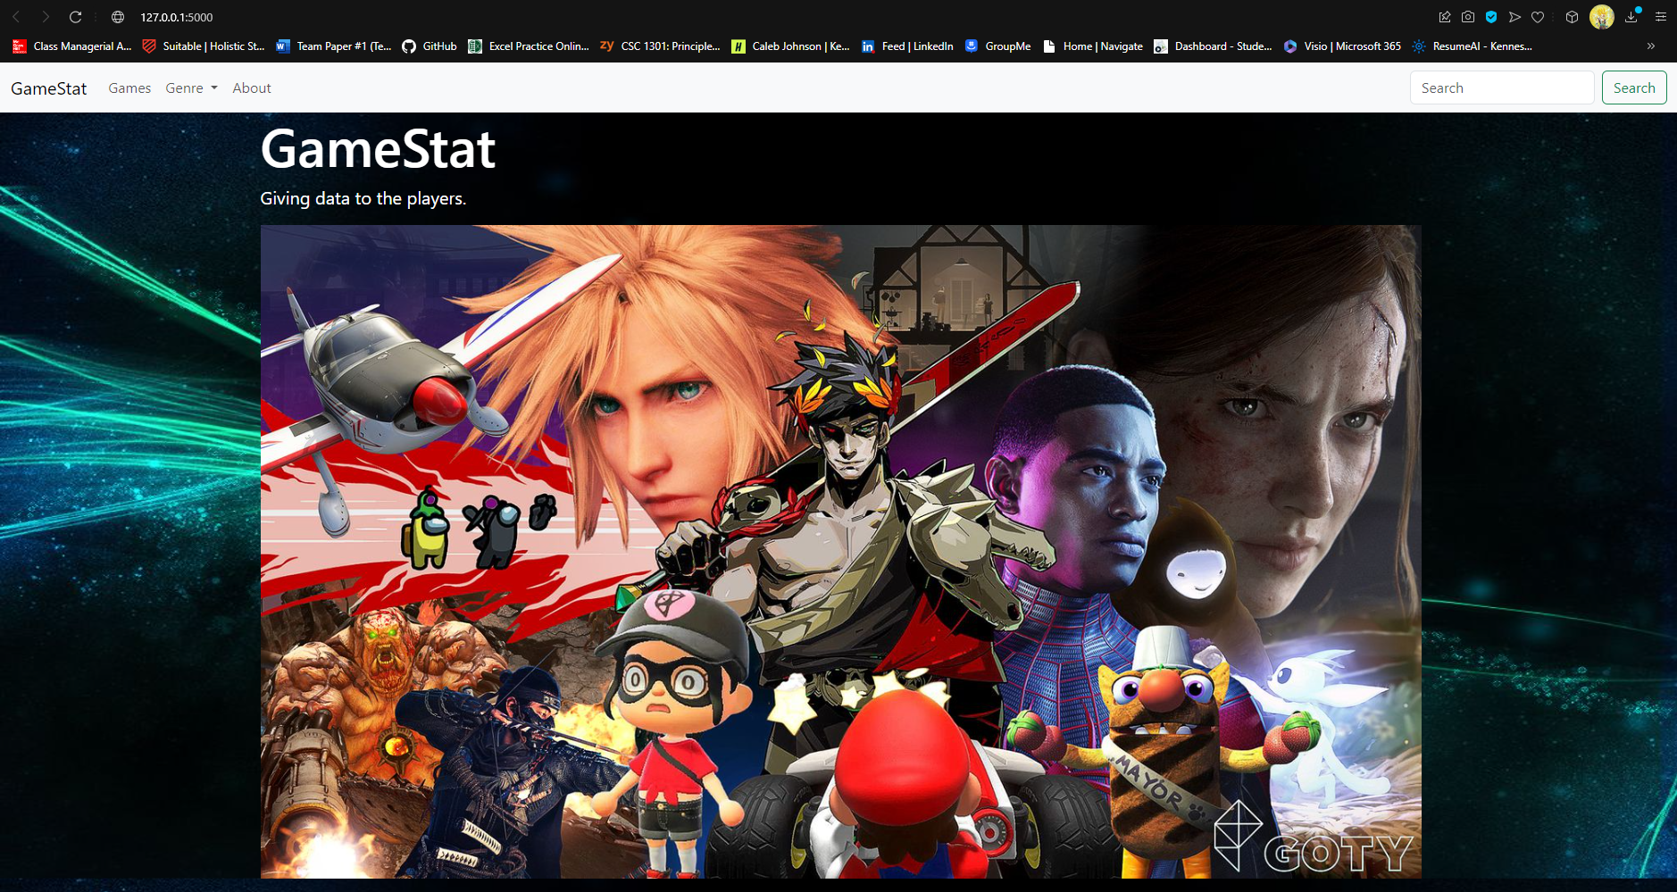

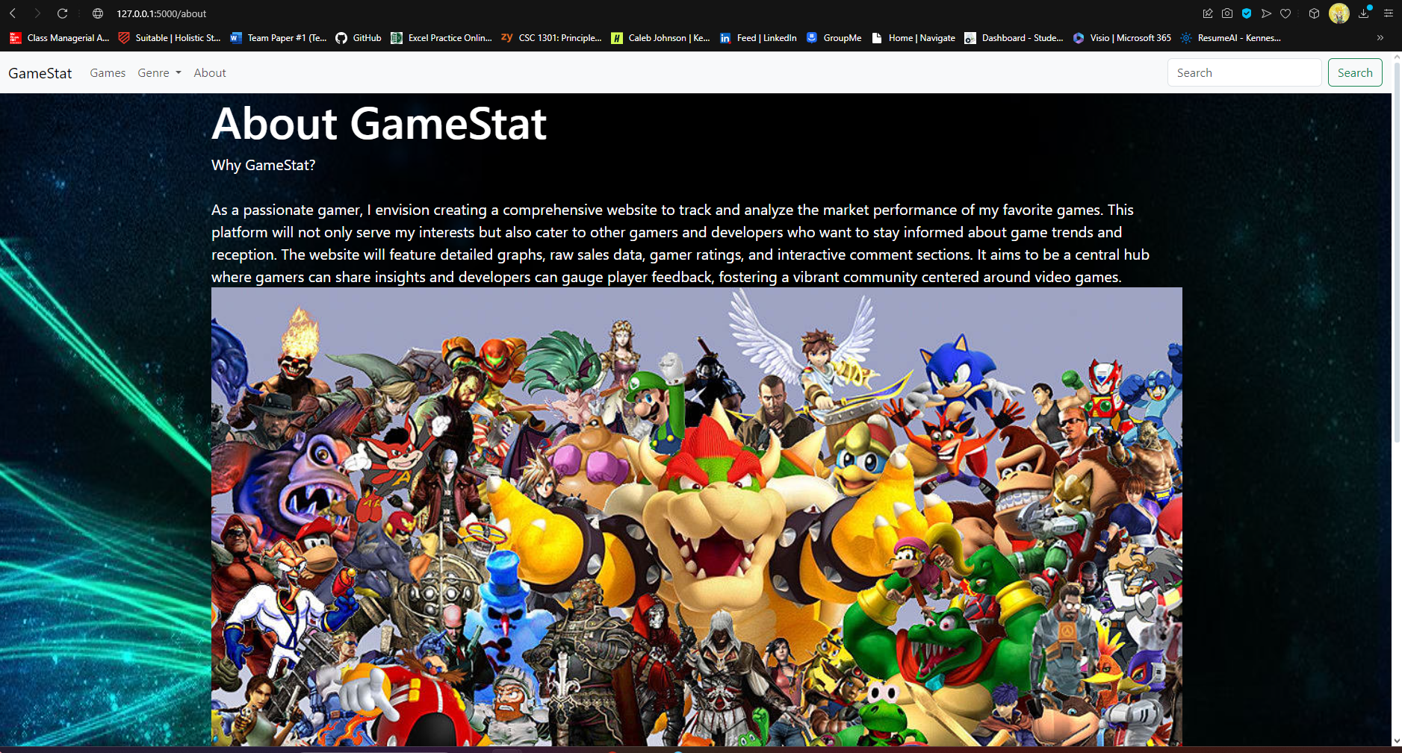
GameStat Giving Data to the Players
By: Caleb Johnson

Slide 2
Striving to become a Data analyst
What was the idea?
- As a person who wants to become a data analyst as well as a person who loves to play videogames, I wanted to make a project that combines the two things I'm interested in.
What Skills are needed to become a data analyst?
- Excel, Sql, Python, R, Powerbi or tableau are the most popular and main skilles needed to become a data analyst.
- This project showcases knowledge in Excel, Sql, and Python with future updates on the way to showcase knowledge in Powerbi

Slide 3
Inspiration and Help
For this website I went to a well known youtuber named Codemy.com who has a full tutorial on how to use python and flask to make a website as well as to make a database with flask. The tutorial was 2 hours and 35 minutes long separated into 11 videos.
When it comes to finding anyone else who tried do a similar thing that I did on GitHub a person named mshawn12 made a video-game-sales-analysis that is very detailed and in depth with machine learning implemented into it.

Slide 4
The Overall Scope and surprises
Looking at mshawn12’s project he had an entire team working on this project so my scope had to be much smaller because I'm only one person, but I also wanted to do something big enough where I can showcase most of my skills as a person striving to become a data analyst.
A surprise/ obstacle that came up in my project is the constant crashing of my website because of it trying to load most of my data
- It took a while to research and figure out a way to load the data in increments and I found out that I needed to use a Paginate.

Slide 5
Next Steps
There are multiple updates I want to add to my project in the future, but these are the main points
- Import Graphs from Power bi
- Implement flak-powered Api (for data)
- Implement a web forum
- Try to use Machine learning in anyway

